Slide 1
DPIs – A Reviewer’s Perspective
Presented by: HSC Unrestricted Accounting
John Brandt, Manager
Stacie Hurley, Accounts Receivable Coordinator

Slide 2
Purpose of this LEARN is to reduced the DPI processing time
It is designed to help you reduce the time in getting your DPIs paid more quickly by:
identifying common DPI processing errors
identifying useful resources
Providing tips & recommendations
This LEARN is not designed to teach you the mechanics of creating a DPI
Notes:
Mention that there are several classes, both online and instructor led. (ie: Direct Pay Training Lab (FIN AP 201)[ How to process and manage reimbursements], Travel Policies and Procedures (EOD 385) [goes into detail on Travel DPIs. ]

Slide 3
It averages 9 calendar days for a DPI to get payment processed after submitted into Banner
FY15 DPI APPROVAL SUMMARY FOR DPI PROCESSING TIME
(CALENDAR DAYS) | As of 2/9/15
Paid DPEZ's w/ Transaction Dates from 7/1/14 - 1/31/15
 | # Days Wait for |  | # Days Wait for |  | # Days Wait for |  | Total Dept |  | Total DPI's
 | Dept Approval |  | Cent Acct Approval |  | AP Check Issue |  | Wait for Check |  | Processed
Contract & Grant Accounting - Main | 3.6 |  | 4.3 |  | 0.7 |  | 8.6 |  | 3,815
FY14 | 3.6 |  | 4.6 |  | 0.8 |  | 9 |  | 7,920
Change | 0.0 |  | -0.3 |  | -0.1 |  | -0.4 |  | (4,105)
Plant Funds/CCMS | 1.7 |  | 2.6 |  | 2.6 |  | 6.9 |  | 72
FY14 | 2.1 |  | 2.5 |  | 3.9 |  | 8.5 |  | 150
Change | -0.4 |  | 0.1 |  | -1.3 |  | -1.6 |  | (78)
Unrestricted Accounting - Main | 2.5 |  | 4.4 |  | 0.9 |  | 7.8 |  | 12,909
FY14 | 2.2 |  | 4.4 |  | 1.0 |  | 7.6 |  | 24,083
Change | 0.3 |  | 0.0 |  | -0.1 |  | 0.2 |  | (11,174)
Contract & Grant Accounting - HSC | 5.8 |  | 5.4 |  | 1.2 |  | 12.4 |  | 3,645
FY14 | 6 |  | 4.9 |  | 1.2 |  | 12.1 |  | 6,188
Change | -0.2 |  | 0.5 |  | 0.0 |  | 0.3 |  | (2,543)
Unrestricted Accounting - HSC | 5.3 |  | 3.7 |  | 0.6 |  | 9.6 |  | 5,804
FY14 | 5.2 |  | 3.9 |  | 0.6 |  | 9.7 |  | 10,813
Change | 0.1 |  | -0.2 |  | 0.0 |  | -0.1 |  | (5,009)
All Accounting Offices | 3.7 |  | 4.3 |  | 0.9 |  | 8.9 |  | 26,245
FY14 | 3.6 |  | 4.4 |  | 0.9 |  | 8.9 |  | 49,154
Change | 0.1 |  | -0.1 |  | 0.0 |  | 0.0 |  | (22,909)
Notes:
Usually either hung up in Dept queue or DPI docs still in Dept’s office
Or
Hung up in core office due to an issue that prevents it being approved for payment
To have your DPI flow quickly through the Core office approval process, it must be approvable when received. Any problems slow the process down.

Slide 4
Basic Terms
DPI – Direct Pay Invoice. All invoices resulting in an amount paid have a DPI number beginning with an “I”
DPEZ – Direct Pay “EZ” form created in FZADPEZ. Every DPEZ that is created will have a DZ number. A DPEZ that results in a reimbursement will have both a “DZ” number and an “I” number
Notes:
Explain zero dollar DPIs
DPEZ is the Banner input form
DPI is the Banner output form

Slide 5
Has the Central Accounting Office received the DPI?
Use the Document Search Data Base
Accessible from Main Campus Unrestricted Accounting website [http://ua.unm.edu/]
Accessible from HSC Unrestricted Accounting website [https://login.unm.edu/cas/login?service=http://galog.unm.edu/]
This allows you to see whether your DPI has been received and approved, or if there is an issue listed that needs to be addressed

Slide 6
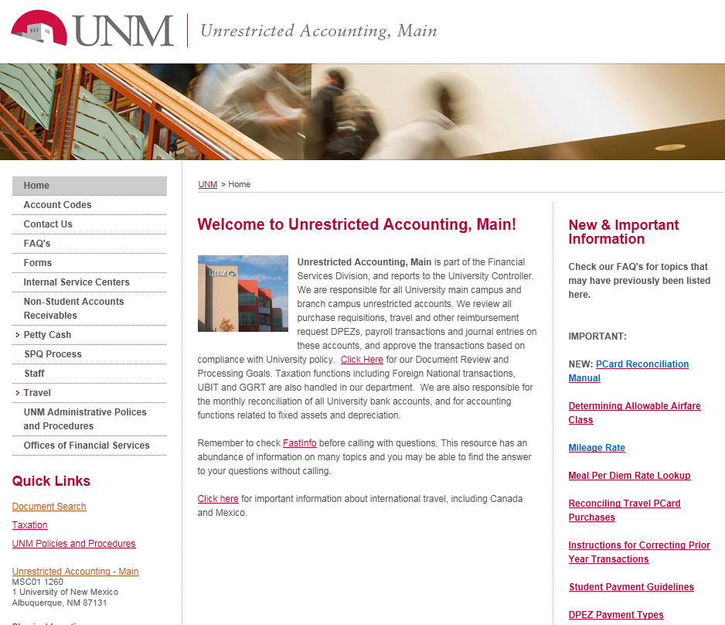
Document Search Data Base – Finding it on Main Campus website
Notes:
Finding it on Main Campus Home Page:

Slide 7
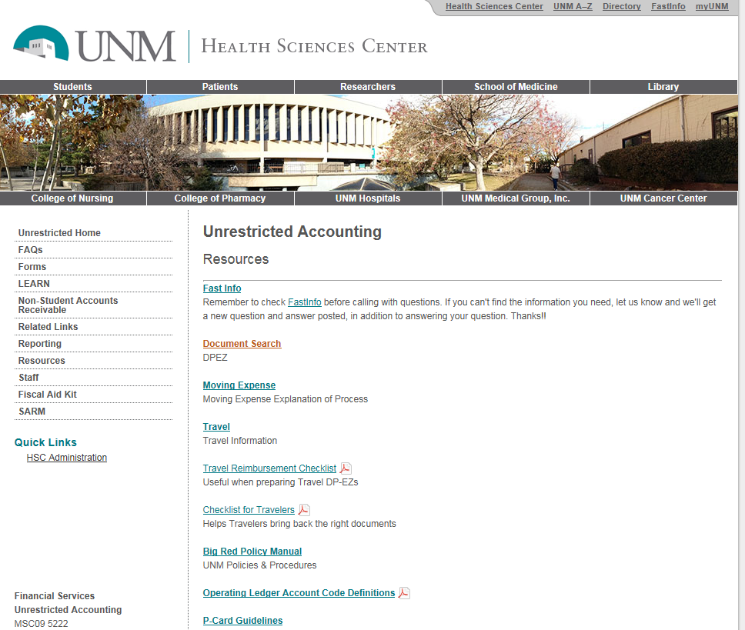
Document Search Data Base – Finding it on HSC Unrestricted website
Notes:
HSC access. You must sign in with your user ID and password. You will be taken to the same site.

Slide 8
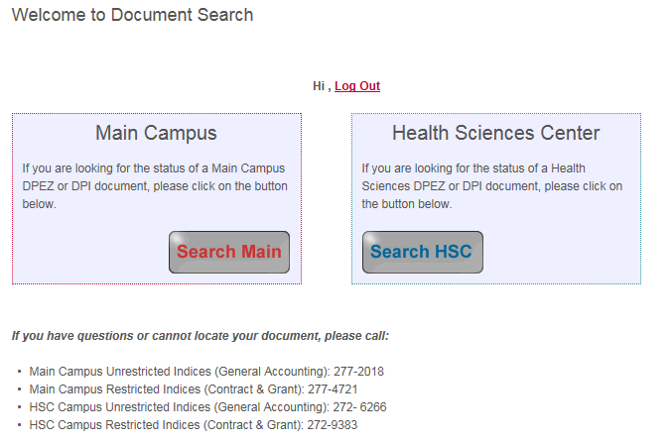
Document Search Data Base – How to Use it
Notes:
Opening page of Document Search database. Select “Search Main” or “Search HSC”. This example uses “Search HSC”

Slide 9
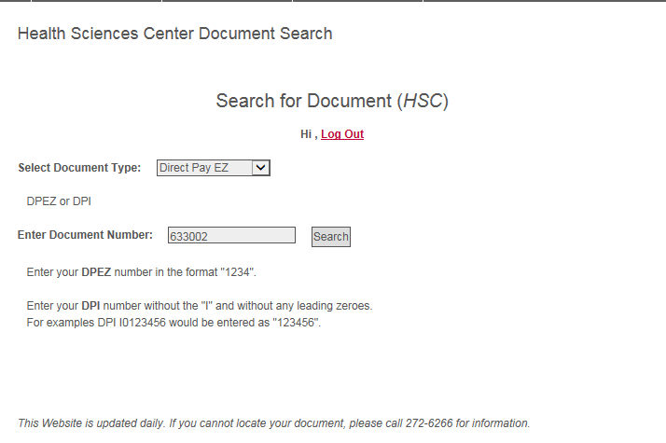
Document Search Data Base – How to Use it
Notes:
Explain the need to drop the “I” if using Direct Pay Invoice number, and drop the DZ and any leading zeroes if using the DZ number.

Slide 10
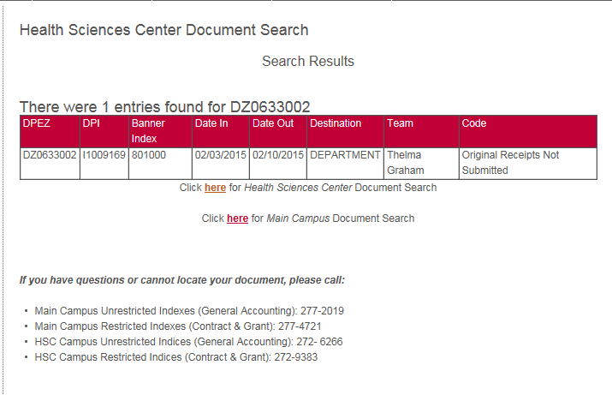
Document Search Data Base – How to Use it
If HSC has not received the documents, there will be no search results
Notes:
This DPI did not have original receipts submitted with it and was returned to the department on 2/10/15. If you have questions (ie: you have not received it back, or have resent it and it is still not approved) call HSC Unerestricted at 272-6266 as indicated below the entry.

Slide 11
Tracking the whereabouts of your DPI:
If database search shows no search results, then:
The core office has not received the DPI
Use Banner form FOIAPPH (document history) to see if the DPI was disapproved
Use Banner form FOAAINP to see what queue or queues still need approval; perhaps a Department Banner Approver has the DPI/backup
Check with your Department approver who signs the DPI to see if that person still has the DPI/backup

Slide 12
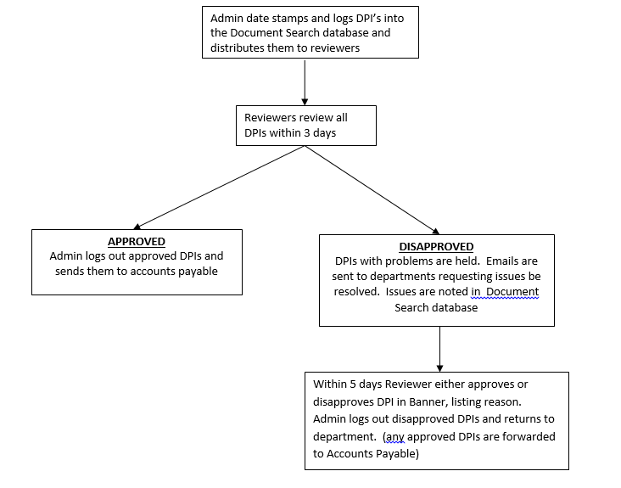
HSC UA Review and Approval: The Big Picture
Notes:
To have your DPI flow quickly through the Core office approval process, it must be approvable when received. Any problems slow the process down.

Slide 13
Approval Process – What Reviewers look for:
“Eyeball the DPI” for correctness
Payee type
Payment/Reimbursement type
Account Code
Travel return date or date of receipt for goods
Per diem rate and number of meals
Mileage rate calculation
Appropriate signatures
Original documents match other listed expenses like lodging or shuttle/taxi
Notes:
Depending on type of DPI (ie: “Goods” versus “Travel”) the accounts used would be expected to be different. The required signatures also differ depending on Payment/Reimbursement type. An incorrect Payment/Reimbursement type can cause a DPI to be returned for missing signatures.
Dates of travel return and date of receipts for goods impact the 60 day IRS Accountability plan.

Slide 14
Approval Process – What Reviewers look for:
Is the DPI taxable per guidelines of UNM’s IRS Accountable Plan?
60 days is calculated:
date when DPI received in core office
date of return for travel
date of receipt for goods or other type
Must be approvable, or still taxable after 60 days
DPI taxable if still in Dept’s queue after 60 days
Recommend review the Accountable Plan guideline at http://ua.unm.edu/accountable-plan-requirements.html
Notes:
*Reimbursement will be taxable if received more than 60 calendar days after the return date (travel) or receipt date (goods)
Received DPI must be APPROVABLE, or corrected and made approvable, within this 60 day timeframe to avoid taxability
If DPI is still in Department’s queue after 60 days, it is taxable

Slide 15
Approval Process – What Reviewers look for:
Payee Type
Anytime the selection is “Foreign Individual or Foreign Company, the DPI must first go to Taxation
Call Taxation for advice if needed
Most Payees are:
UNM Employee
US Individual or US Company
Notes:
Types include:
UNM Employee
UNM Student
UNM Foreign Student
US Individual or US Company
Foreign Individual or Foreign Company
Best Practice: Send foreign individual or Company DPIs to taxation first. Taxation will forward them to us after their review.

Slide 16
Approval Process – What Reviewers look for:
Payment/Reimbursement Type
Select the correct type
Most departments use only a few types:
Conference Registrations
Dues, Fees
Goods
Moving Expenses
Participant Fees
Travel
Recommend review Types of Payments that are Allowed on a DPEZ at http://ua.unm.edu/dpez%20payment%20types.html
Notes:
Primary Types include: RARELY used:
Books, Periodicals Refunds=returning money
Conference Registrations Paid to UNM to the payor
Damages or Settlements (ie: student tuition)
Dues, Fees
Goods Royalties
Moving Expenses
Notary Public Applications
Participant Fees
Refunds
Royalties
Travel
IT IS IMPORTANT TO GET PAYMENT TYPE CORRECT SO THAT THE PRINTED FORM HAS THE APPROPRIATE SIGNATURE LINES

Slide 17
Approval Process – What Reviewers look for:
Appropriate Account Code
This is the expense account
Do NOT use a revenue account
Some flexibility is allowed here
Certain account codes must be used that pertain to IRS or State requirements, tracking or reporting requirements
Ex. - UNM owned Computers must go to 3189 and Moving Expenses must go to 38L0
Recommend read Account Codes Revisited LEARN at http://hsc.unm.edu/financialservices/accounting/LEARN.shtml
Notes:
3189 = UNM owned computers, Laptops, IPADS
3180= Resident owned computeres, laptops, IPADs
9020=Computers over $5,000
38L0=Moving expenses. These include house hunting trips.

Slide 18
Approval Process – What Reviewers look for:
Per diem rate and meals
Verify per diem rate is correct
Hawaii/Alaska/foreign country city is Local Meals rate plus Local Incidental rate
Verify number of meals match airline itinerary and meals paid by conference are subtracted or any allowable business meals are subtracted
Notes:
If the document requires documents to be sent with the check; make copies.
UNM keeps the originals you have attached.

Slide 19
Approval Process – What Reviewers look for:
Appropriate signatures
If the correct Payment/Reimbursement Type is selected, the correct signature lines will be printed on the DPI
Have each line signed before forwarding
Notes:
If the document requires documents to be sent with the check; make copies.
UNM keeps the originals you have attached.

Slide 20
Approval Process – What Reviewers look for:
Original Documents
Required
If not available, include memo accepting department responsibility for any duplicate payment; memo must be signed by payee & Dept Head
Restaurant receipts must include detail & list of attendees
If not available, a memo stating no alcohol was purchased required
Evidence of payment by payee required
Zero dollar balance, credit card payment
Notes:
Shipping documents for books/periodicals will also be accepted as “proof of payment”
If a memo stating alcohol was not purchased, move the amount to 31B0

Slide 21
What causes the processing time to increase for DPIs once Core Office has received the DPI?
DPIs were disapproved because an item had to be changed and the DPI re-submitted
This adds time to get payee paid – time to make correction, time to get Department approvals again, time for Core office to review and approve, etc.
Additional information was requested that is needed to verify and approve the DPI
This adds time to get payee paid – time to get information, time for Core Office to review, etc.
About 1 in 8 DPIs received at HSC Core Offices has some issue that needs to be resolved before the DPI can be approved
Notes:
This information was extracted from our DPI log database for both Unrestricted Acctg and HSC C&G
We typically will deny a DPI after 5 days if we do not get any response on additional information requests

Slide 22
Travel DPIs
Comprise 27% of the denied HSC Unrestricted DPIs
Use the Travel Checklist
Get the per diem correct
Explain any unusual items or circumstances in Business Purpose or Additional Information sections
Include the brochure or agenda
Include airline itinerary
Include original receipts & all prepaid items
All the above is needed by Core Office Reviewer to verify DPI is okay to pay
Notes:
Unusual circumstances can be explained in a memo, the business purpose, or as special circumstances. Just explain!

Slide 23
DPIs Never Physically Received
Are the next biggest reason for the denied HSC Unrestricted DPIs
Account for 21%, or 1 in 5 DPIs denied because we never received them; use DPI database search and FOAAINP
The DPIs are in our approval queue, but never physically received and are denied after 10 business days; this helps alert you that we never received the DPI, and the 60 day IRS Accountable Plan clock is ticking
Check Banner form GUAMESG for message
We recommend that departments review their business practices to help reduce this problem
Notes:
Make sure your DPI is physically sent to the Core accounting office. DPIs cannot be approved until they are physically received. They are denied in the approval queue after 10 days, and must be completed again, and sent to the Core office.

Slide 24
Other reasons for DPI disapprovals
Wrong account code was used; 11% or 1 in 10 DPIs
Insufficient backup received
Insufficient response time to request
Insufficient business purpose
Math or date error
Wrong form or payee type used
Sales tax not allowed
Against UNM policy or guideline
All of these reasons can be prevented and reduce the time it takes to get the DPI paid
Notes:
These are DPIs we have physically received and reviewed, but cannot approve because department approval has not been completed.
Importance of tracking DPIs you originate through to approval and payment
Use FOAAINP to see next approver and contact if necessary to get your DPI approved
Use FOIDOCH to see if a check has been cut or direct deposit made for your DPI

Slide 25
Special Handling Mismatches
This DPI, to an individual or company, is to have the check held for pickup.
If the Special Handling is to “mail document with check”, a copy of the document needs to be included with the DPI
Notes:
This is correct. A check is being cut, and and the check is to be held for pickup.

Slide 26
Special Handling Mismatches
This DPI, to an employee, says it will be deposited directly.
It also says to “mail document with check”
This is incorrect. A direct deposit does not include any mailing and must be manually sorted out in AP
Notes:
This is incorrect correct and wastes considerable time in AP. A check is not being cut, and the discrepancy between checks cut and the number of documents to be “mailed with check” must be manually sorted out in AP. Draw a line through the “Mail document with check” line if this occurs, before sending
**May mention (if time allows) how to view document in Xtender, and view the Taxable stamp we place on taxable (or partially taxable) DPIs.

Slide 27
Helpful Tools
URL handout gives useful sites
Visit the Main Campus website
http://ua.unm.edu/travel/travel-information.html
http://ua.unm.edu/faqs.html
Read thoroughly and keep within arms length Policies 4000 and 4030 http://policy.unm.edu/university-policies/4000/4030.html
Review HSC related LEARN sessions http://hsc.unm.edu/financialservices/accounting/LEARN.shtml

Slide 28
“Own the Process”
Follow the life of the DPI all the way through to make sure the Payee is paid
Do not assume your job is done after you complete the DPI and send it off
Use the Document Search Database
Look in FOAAINP to see who has not approved
Check FOIAPPH to see history
Use FOIDOCH to see if paid or status
Communicate with the Core Office for assistance

Slide 29
Tips for DPI Processing
Should be at least 2 persons set up in your Department’s approval queue; when only one person is in the queue it really slows down the process if the Approver is on leave
Be sure to follow up ASAP and provide the Core Office with any requests for additional information or missing backup
Remember to complete DPI and put DPI back in the queue, then request Department Banner approver to approve it again in the queue
Use the Travel Checklist and put the backup documents in order of the checklist

Slide 30
Tips for DPI Processing
Only use one staple per DPI; it is easier for Imaging Department to handle when scanning into Xtender
Do not staple multiple DPIs together
If you need to disapprove your DPI:
Deny the DPI (use Banner form FOADOCU)
Only originators or the approval queue people can deny a document in FOADOCU
Go back into Banner using form FZADPEZ & make your changes
COMPLETE the DPI again, making sure it is back in the Banner queue, get Department Approver to approve it again

Slide 31
Tips for DPI Processing
When deleting a record:
Delete the record properly
Manually check the DPI’s calculations
It is not necessary to print DPI form as 2-sided for our benefit; makes it harder to scan to Xtender
Use Banner form FOIAPPH to see DPI document history
Use GUAMESG to look up the reason the DPI was denied by the Core Office
Core office may also send an email with more detail

Slide 32
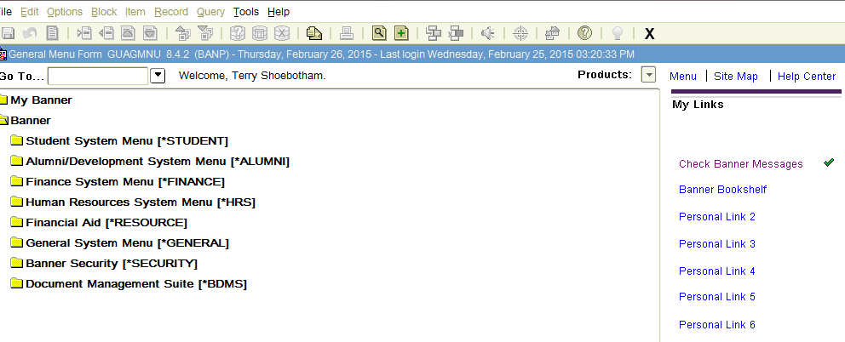
GUAMESG
Notes:
When you sign into Banner, select “Check Banner Messages”

Slide 33
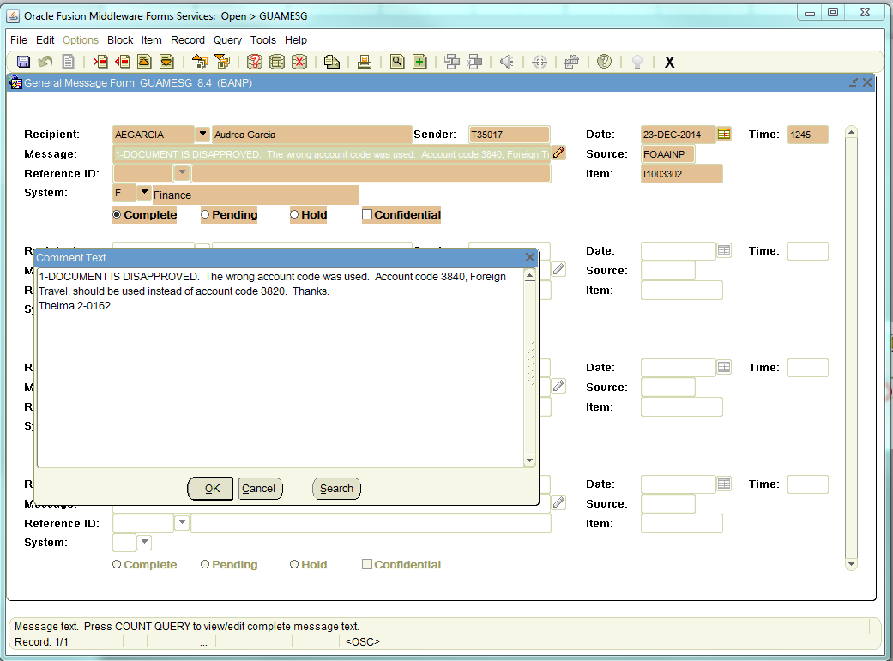
GUAMESG
Notes:
The message above can be seen in it’s entirety by clicking on the pencil. The document number will also be indicated.

Slide 34
Helpful Banner Screens
Form | Use
FOIDOCH | See if check has been cut for your document; can check status of check using Options Menu
FOAAINP | See who is the next approver for your document
FOIAPPH | See the approval history of your document
FZIDPEZ | View and print any DPI
FOADOCU | Disapprove your own DPI

Slide 35
Summary
“Own the Process” to help narrow down the time it takes to get the payee paid as presented in this LEARN
Review and know where to find the pertinent UNM policies and guidelines
Apply your training and knowledge by carefully creating and tracking DPIs for your department
Apply your training and knowledge by helping others in your Department
Notes:
Get a show of hands for persons interested in a travel toolkit that could be put on their desktop
Links to travel resources, policies, guidelines, key contacts, key points, etc
Instead of having to go look up each time yourself
ALL IN ONE SPOT – JUST CLICK THE LINK, ETC

