Slide 1
Effort Certification Training
UNM
Rosa Gonzalez-Rosenblatt
8/14/13
Notes:
Welcome to effort certification training at the University of New Mexico. This training is for the individual who will be reviewing employees working on externally funded research or other sponsored projects. This most commonly is the department administrator, and is identified in the system by the PI.

Slide 2
UNM Effort Certification Training
Pre-Review Stage
Notes:
Good afternoon, and welcome to the effort certification training. This training is for the individual who will be reviewing employees working on sponsored research projects. In most cases this is the Department Administrator or Accountant identified by the PI and entered in the system as the Account administrator.
In this presentation I will be covering what effort is, why we have to certify and how to review a record. I will go over 3 different scenarios on what to do to review a record and I will point out the various options and features of the effort reporting system as I go.
I encourage you to ask any questions throughout the presentation; however, if your question is very specific, please wait until the end to address the question.

Slide 3
What is Effort
Effort is the time spent on a sponsored project, it is expressed as a percentage of the employees’ total University related duties
  Effort must equal 100% cumulative total
    Includes teaching and research activities
    Does not include any activities outside of University related work
  Cannot exceed 100% if working on multiple projects
  It is not measured on a standard 40 hour work week, but on the actual time worked.
Effort Certification Policy in UNM Faculty Handbook
Notes:
It is important to know that effort is not measured on a 40 hour work week but rather on actual time worked. For example: if you work 60 hours during a week and 30 hours is worked on a grant, your effort is 50%.
Faculty hand book section E: Research (E120)

Slide 4
Why do we Certify?
Effort is a mechanism to confirm salaries and wages charged to a sponsored project in relation to the work performed and committed to the agency in proposal.
  UNM is required to assure Federal and other award sponsors that the allocation of salaries charged are fair, consistent and timely with the effort performed.
    Potential financial penalties for non-compliance
    Expenditure disallowance – department would be responsible to repay the charges to the agency
    Non-compliance on A-133 audit - could impact future funding
Applies to non-timesheet employees only
Notes:
Effort certification is a federal requirement. This requirement applies to monthly non-timesheet employees.
By accepting sponsored projects the University agrees to the terms and conditions of the federal government for managing tax payer’s resources.
The potential consequences for non-compliance include:
Financial penalties
Expenditure disallowance
And audit findings on our annual A-133 audit which could impact future funding for the University

Slide 5
Effort Certification Process
Certification reports distributed and certified semi-annually through LoboWeb
  Pre-Review Stage
    30 calendar days after reports are generated
  PI Certification
    Begins when Pre-Review stage is completed
    Ends 60 calendar days after reports are generated
  Email notifications
    Initial email to Pre-Reviewer only
    PI will receive one email at end of 30 days
    Reminder and delinquent notifications will also be sent
Pre-Review must be completed prior to Certification
Notes:
The effort certification process at UNM is done semi-annually. The reports are available through Loboweb. The process has 2 stages. A pre-review stage and a certification stage.
The Pre-Review stage is completed by the account administrator as designated by the PI. This individual reviews and processes corrections if needed to the effort report prior to the PI’s certification.
The Certification stage is completed by the PI who will certify employees effort after the Pre-Review stage is complete. If there are multiple PI’s for an employee, each PI must certify.
The initial email goes to the Pre-reviewer only. After 30 days and email is sent to the PI. This email includes a list of employees that are ready for certification. The PI’s receive weekly updates listing all employees that are awaiting certification
Reminder and delinquent emails are sent to both the Pre-reviewer and the PI’s to ensure reports are certified timely. Delinquent emails sent to the PI’s will be copied to the Department Chair/ Director.
The entire process should take 60 days.

Slide 6
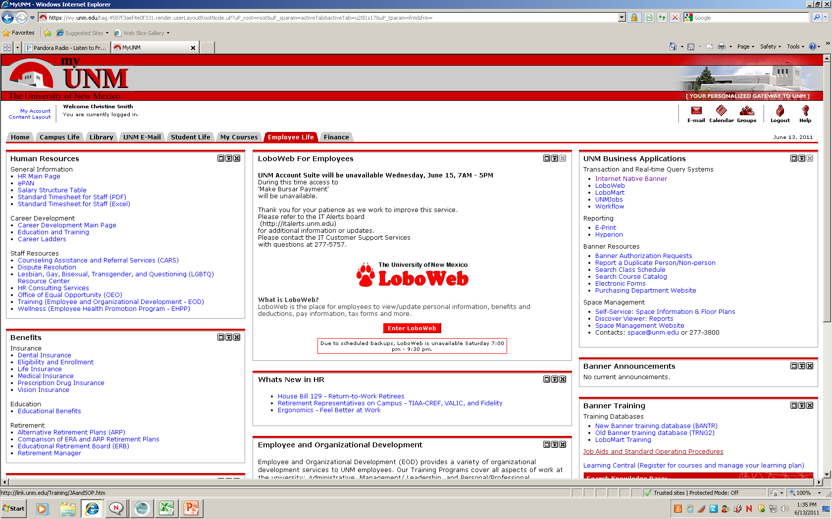
Accessing Reports
https://my.unm.edu/cp/home/displaylogin - to log into LoboWeb
Select the Employee tab - Click on Lobo Web
Notes:
To log into the system go to My.UNM.edu Select the employee life tab, and then click on Lobo Web.
For new pre-reviewers. To access the system you will need to take EOD class 932 Effort certification Training for Departments (Department Administrator) available through Learning Central and then request the BAR role: “Department Effort Certification reviewer” this role is listed under the Contract & Grant accounting Roles

Slide 7
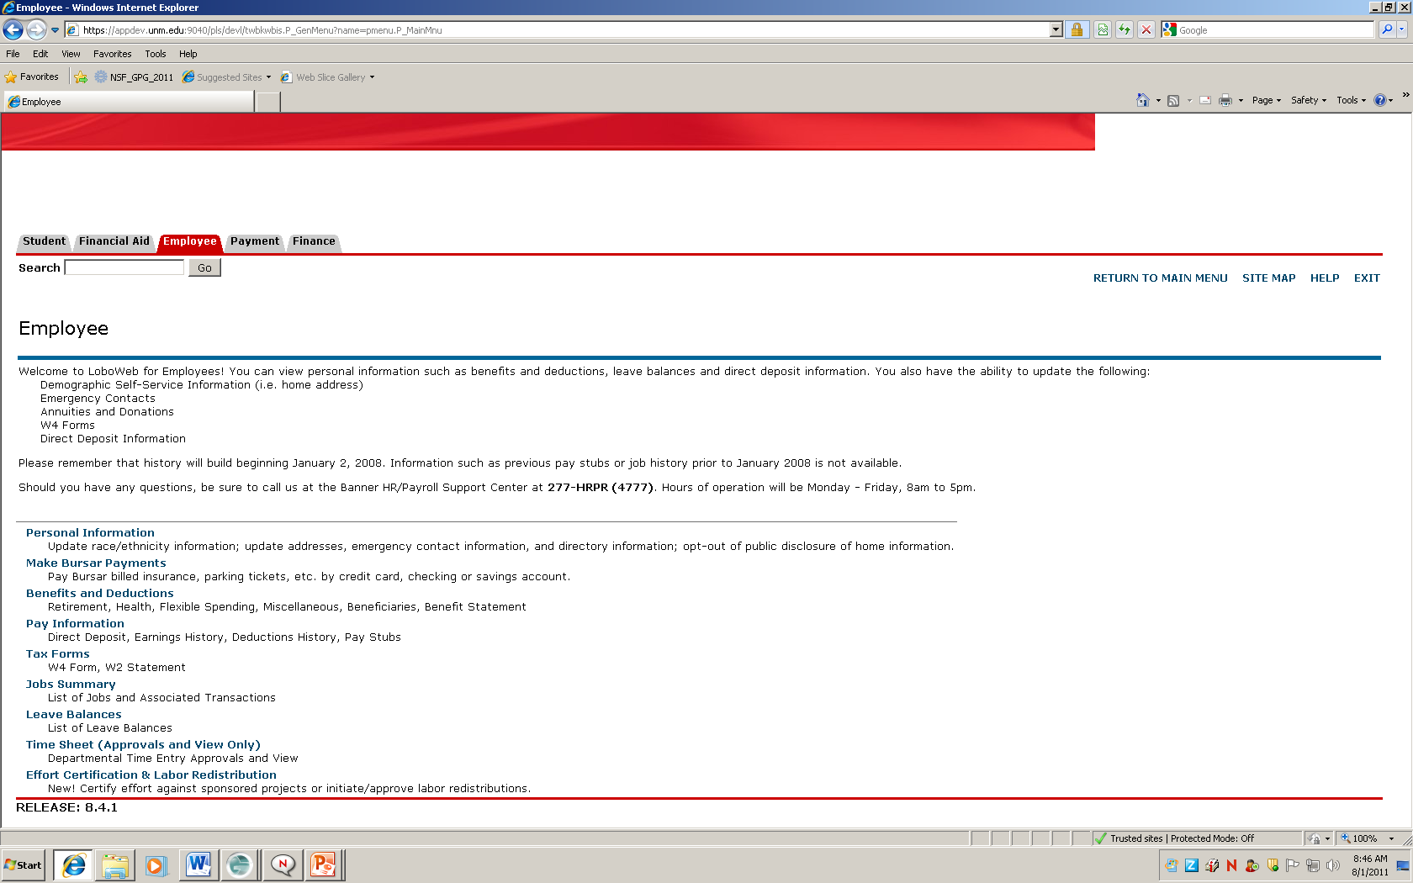
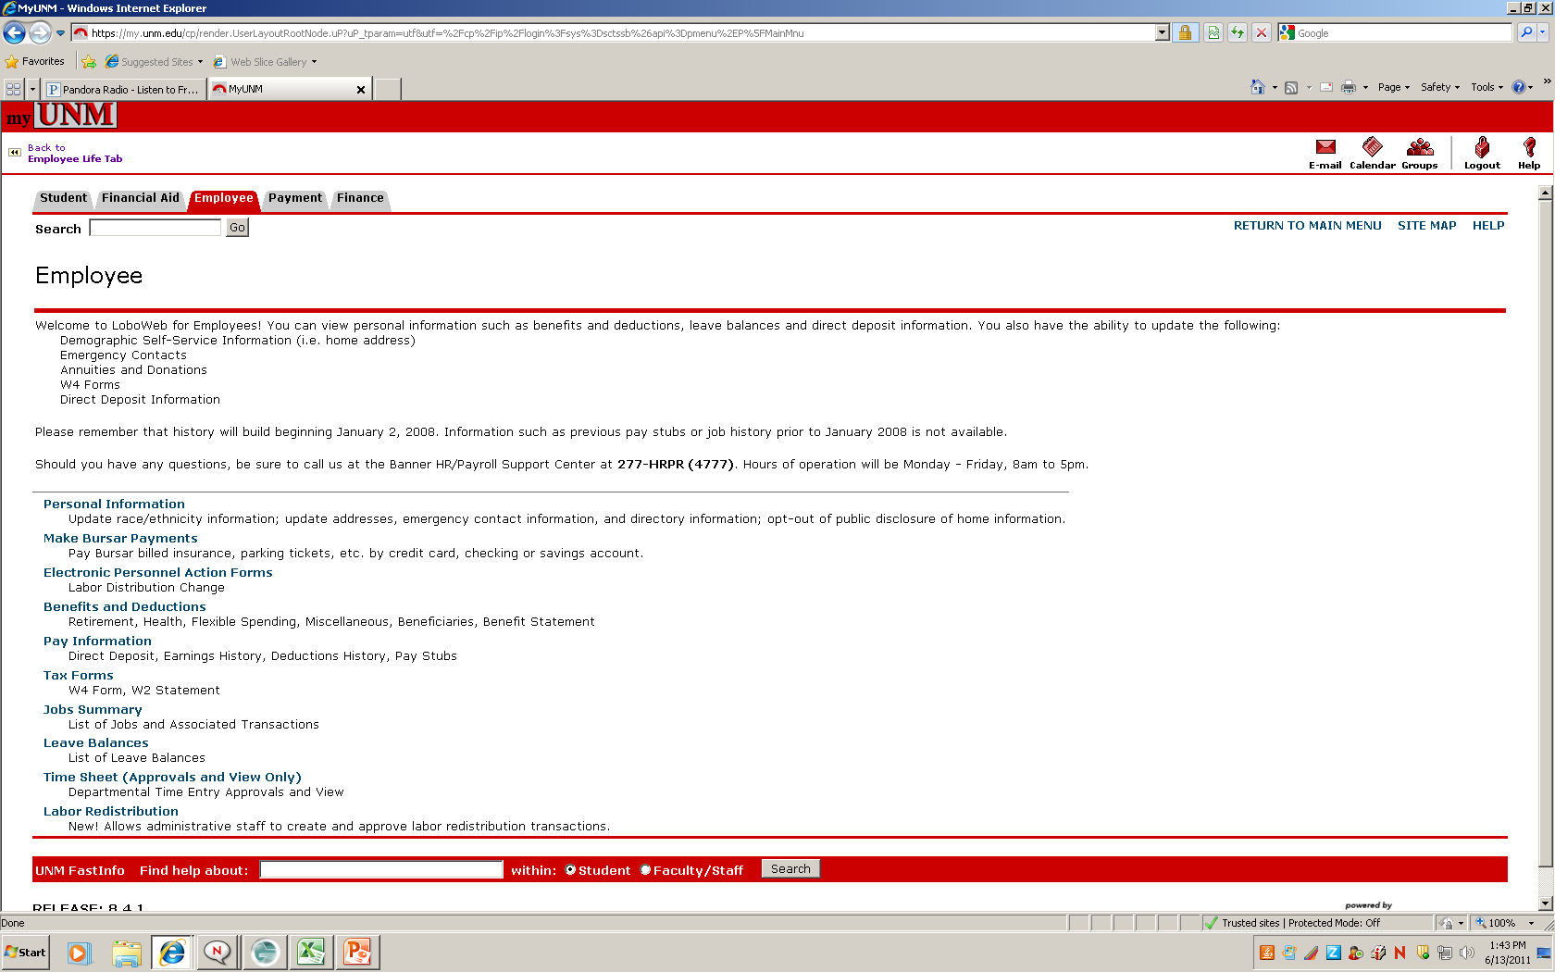

Select Effort Certification
Notes:
From the employee tab select the effort certification link

Slide 8
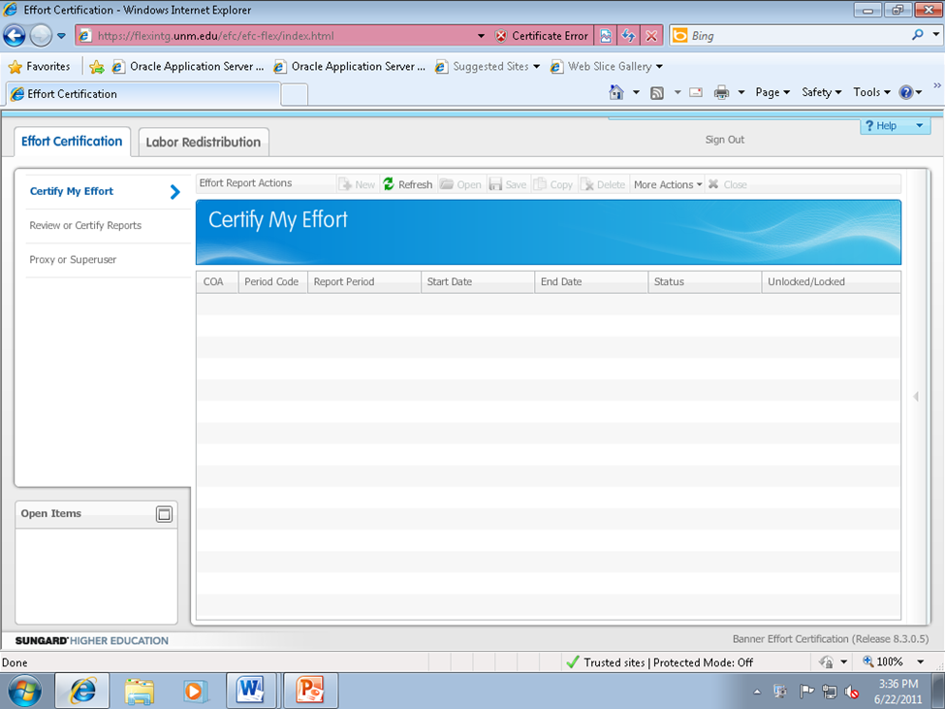
Select Review or Certify Reports
Notes:
To see the list of employees you are to review, select the ‘review or certify reports’ tab located on the left of the page.

Slide 9
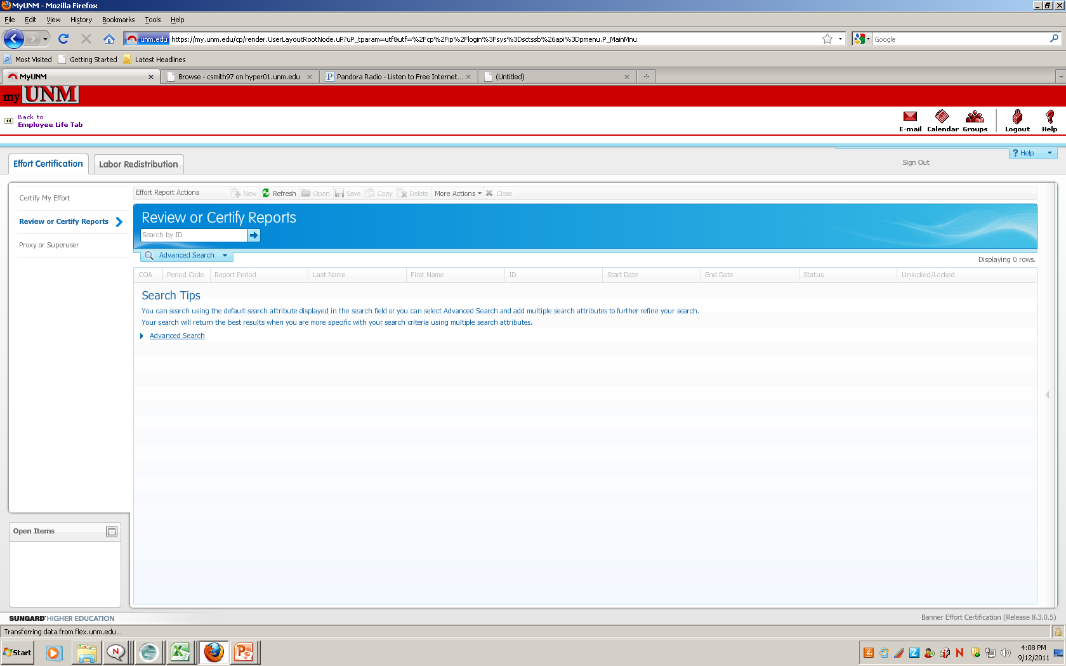
Click Advanced Search
Click advanced search to view search options
Notes:
Next click the advance search drop down tab.

Slide 10
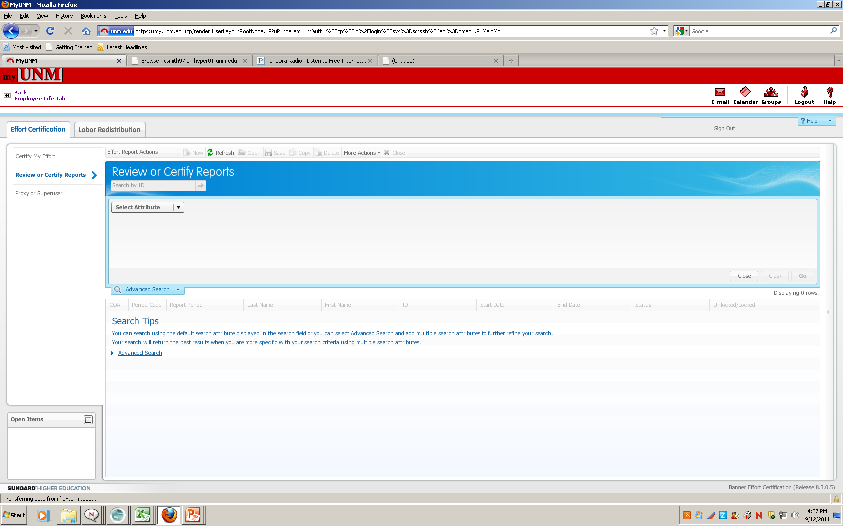
Select Attribute to Begin Search
Open drop down menu to select the search attribute
Notes:
The ‘select attribute’ tab will be displayed, click the drop down menu to select the search attribute

Slide 11
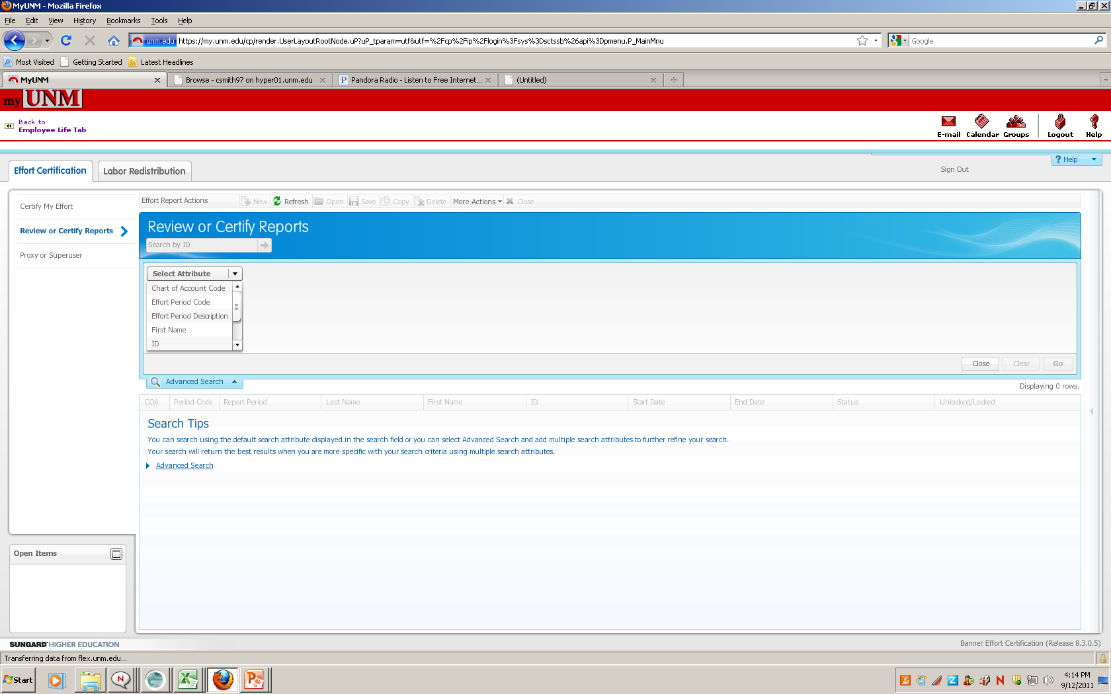
Open Search Drop Down Box – Chart of Accounts
Open drop box, select Chart of Account Code to begin search
Notes:
Select ‘chart of account code’ from the drop down box

Slide 12
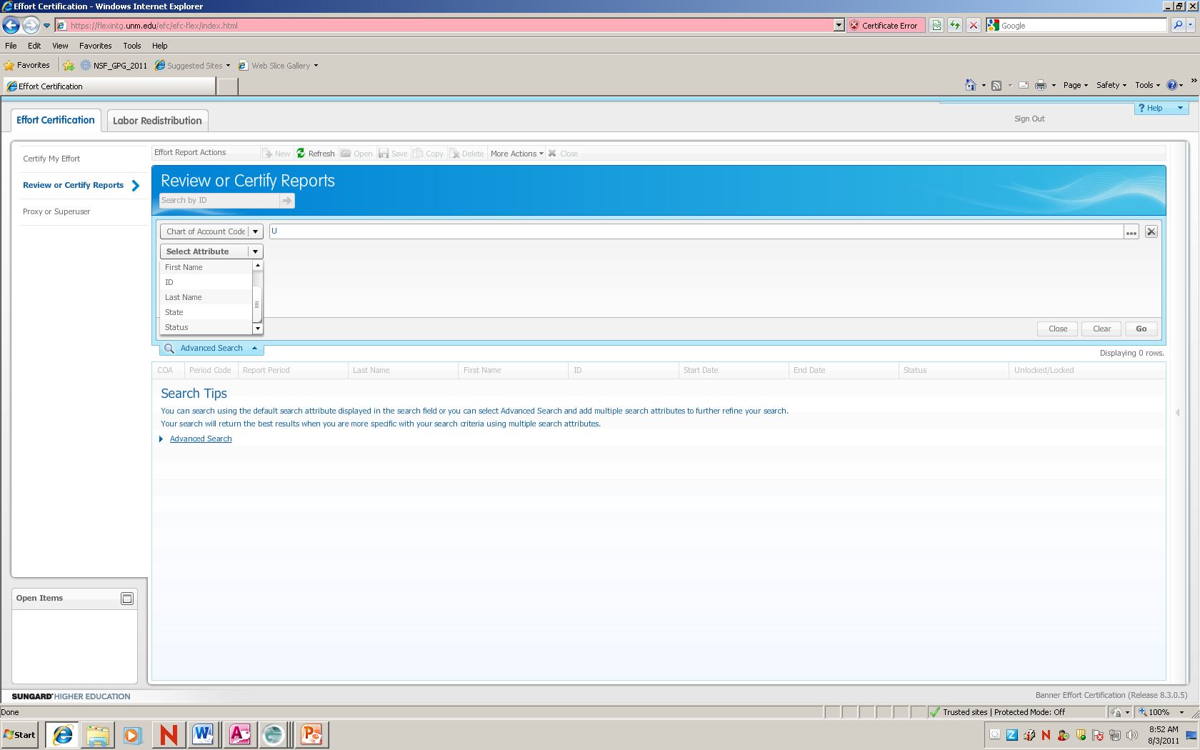
Search for Reports to Review
Select Attribute drop down
  Chart of Accounts – type “U”
Notes:
Type ‘U’

Slide 13
Search for Reports to Review
Select Attribute drop down
  Effort Period Code – type “201301” and hit Go. System will display all records that you have access to view
Notes:
Click on the ‘select attribute’ drop down menu again to select the ‘Effort period code’
Type ‘201301’ and select the go button located on the right of the screen.

Slide 14
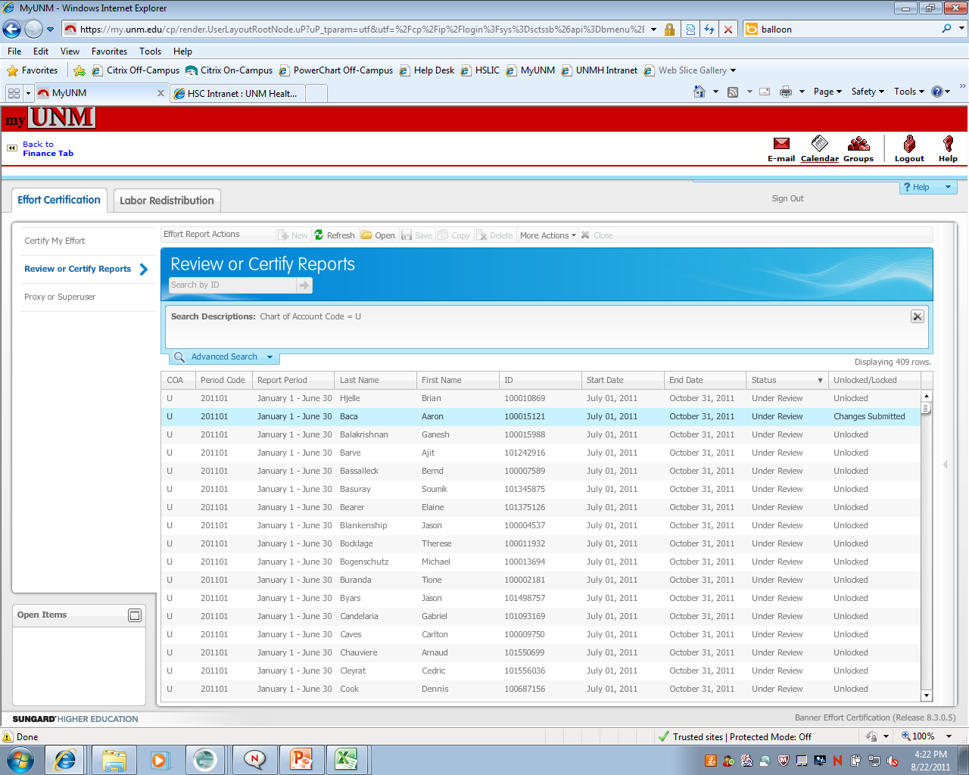
Select from Employee List
Highlight record, double click to view effort report actions
Note Status and State of each employee
Notes:
A list of employees is now displayed. You may sort each column by clicking the top of the column. You may expand a column by clicking and dragging the line in the column you would like to expand. Note the status and state column. Only effort reports with a status of Under Review require your action at this time. To view the effort report, highlight the record and double click.

Slide 15
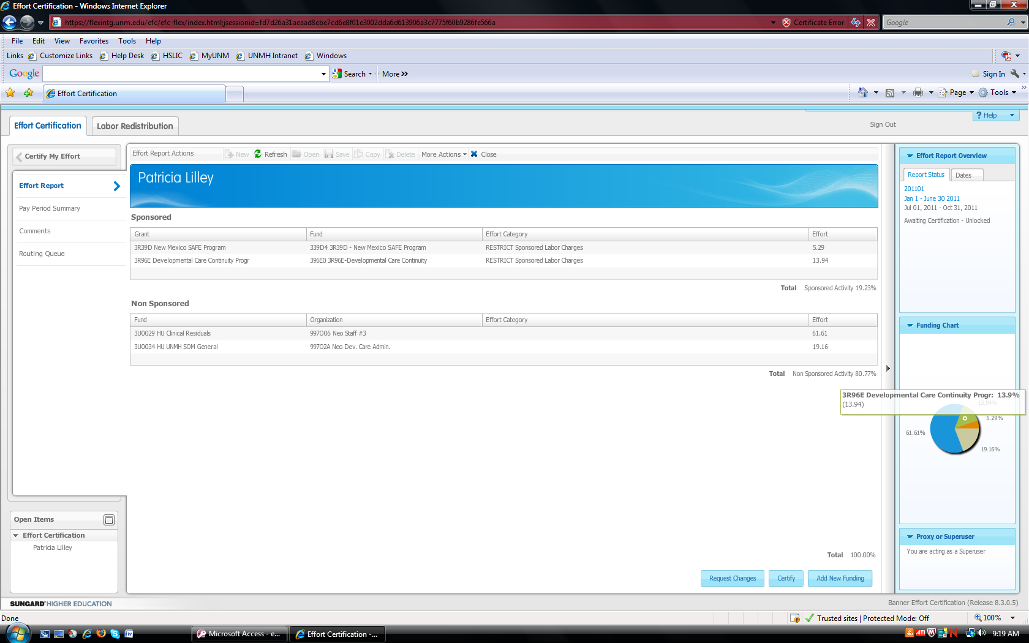
Employee Effort Report
Salary distribution is displayed as percentage; a pie chart also displays the salary distribution
Tolerance +/- 5% original award vs. effort worked
Status
Notes:
The effort report tab displays the Sponsored and Non-sponsored distribution for the employee selected.
The effort is displayed as a percentage of the total salary paid to the individual during the 6-month certification period.
The panels along the right hand side show you the status and state of the record and the pie chart displays the salary distribution

Slide 16
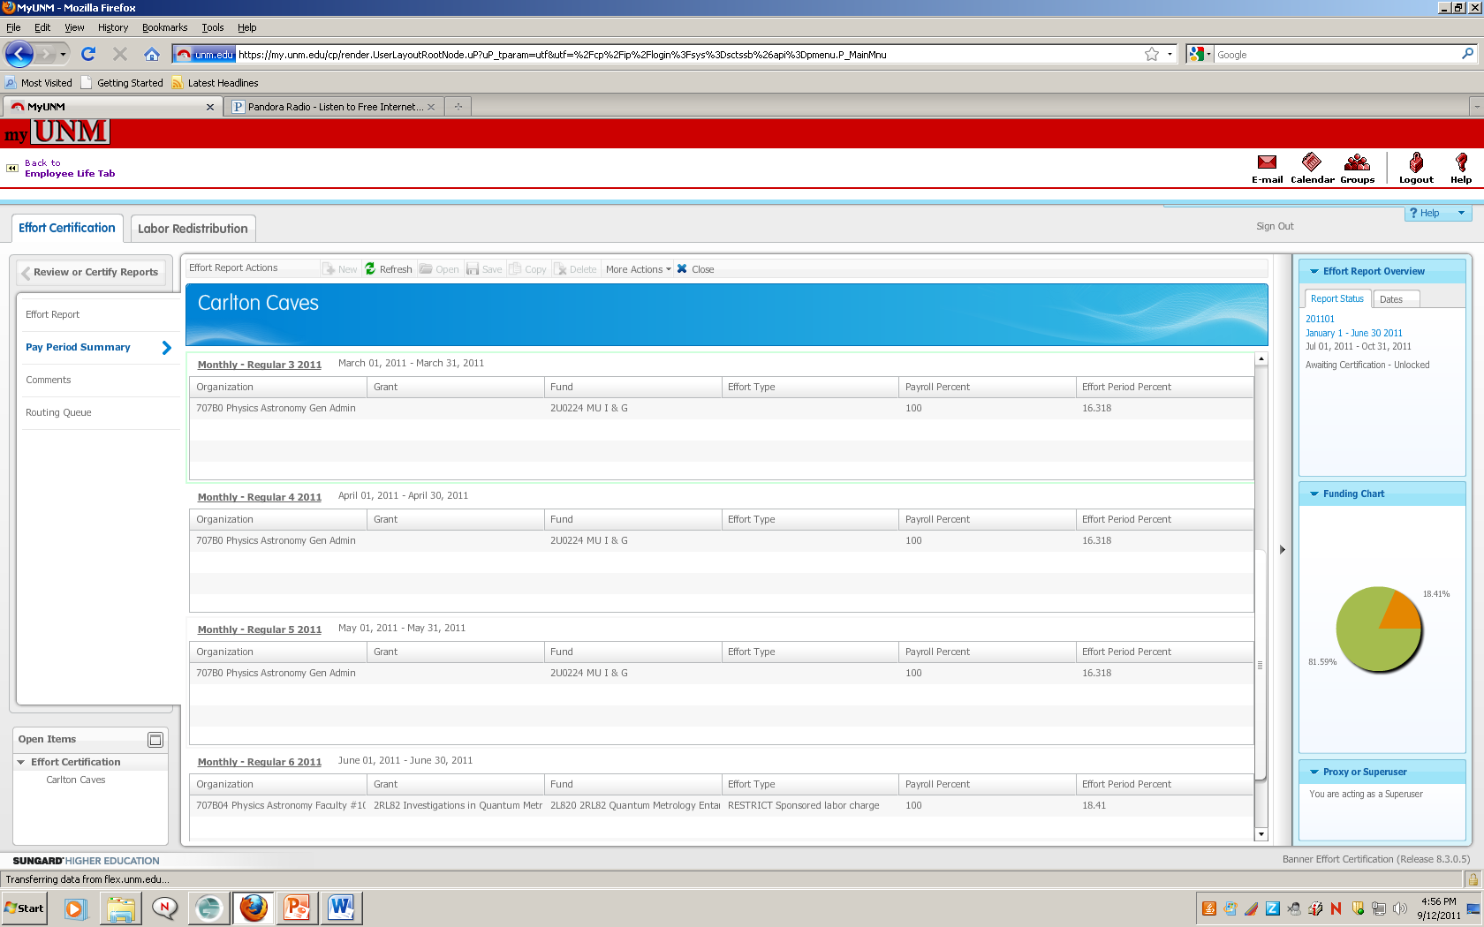
Pay Period Summary
Select Pay Period Summary to view effort by pay period
  If grant is not active over whole effort certification period, this is where you can view detail by month
Notes:
Select pay period summary tab located on the left of the screen to view effort by pay period.

Slide 17
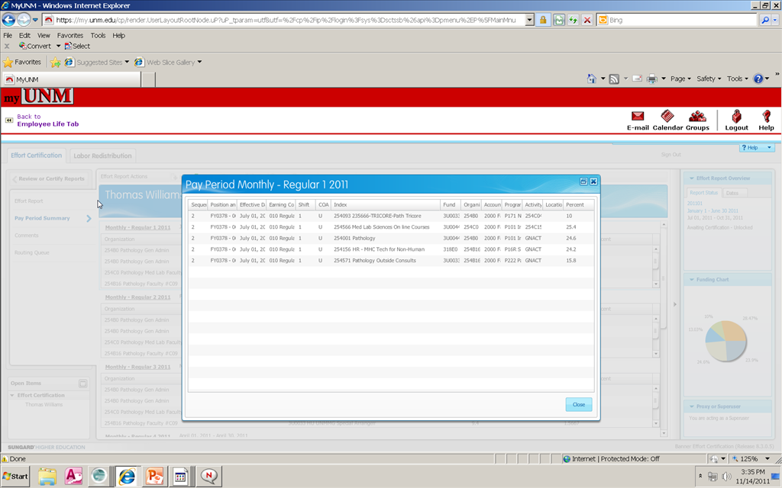
Pay Period Summary
Select Monthly – Regular link to view FOAPA detail including index
Notes:
This allows you to see the details for the pay period such as index and earnings codes.
If you need to see dollar amounts, I recommend you take a look at the Eprint report

Slide 18
Routing Queue
Notes:
In the Routing Queue tab you can see who is in the routing queue, the actions that have taken place as well as the need ones needed to take place

Slide 19
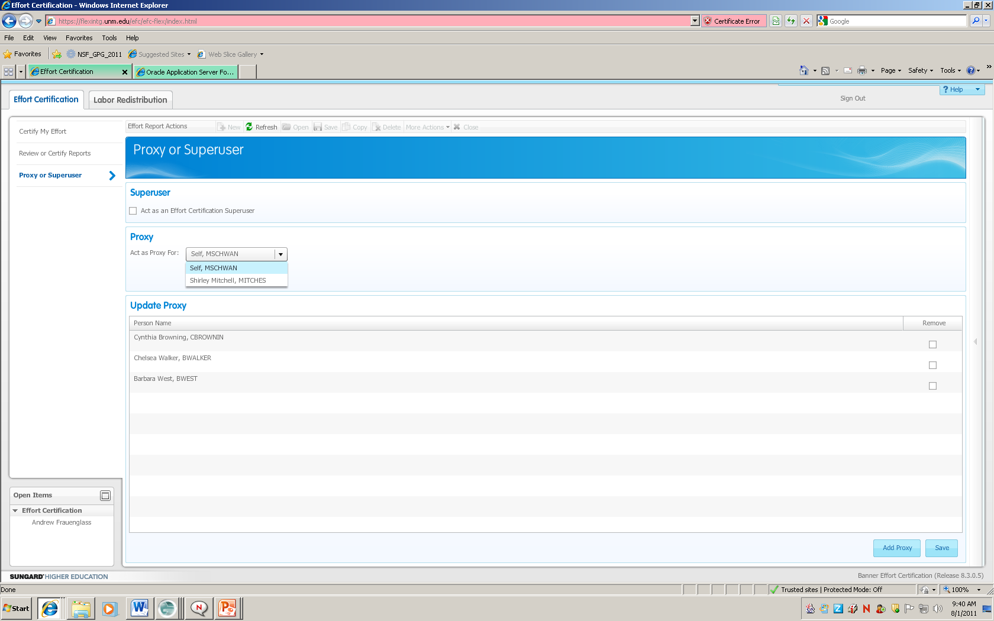
Selecting and Adding Proxy Access
Act as Proxy for someone that has given you authority
Add Proxy to give authority to someone to act on your behalf
Notes:
To add a proxy to act on your behalf or act as a proxy for someone that has given you authority select the “Proxy or Superuser” tab. The middle section labeled proxy is where you would select the individual who has granted you proxy access. The bottom section labeled Update Proxy is where you would select the Add Proxy and type in the individual who will act as your proxy and then select save. You also can check the box to remove a proxy.

Slide 20
Navigation Tips
Scroll Bar
  Click F11 if you have multiple items listed under sponsored projects and cannot see the scroll bar
Expand the columns
  Click on the line you would like to expand and drag the line to make the column larger
Sort columns
  Click on the top of the column you would like to sort by, you can sort by any of the columns listed
View routing queue
  Select Routing Queue link on the left panel, to view all individuals in the queue and what actions have been or need to be taken
  Note: The employee name will appear on routing queue as certifier, the only time they will be required to certify is if they are also the PI
View Effort Breakdown by Pay Period

Slide 21
Column Definitions
Status column:
Under Review – report has been created and is available for viewing
Awaiting Certification – Pre-Reviewer has reviewed and is ready for certification
Completed – effort report has been certified and completed
Locked/unlocked column:
Locked – after an effort report is completed it is locked and cannot be modified
Unlocked – effort report is available for change by members of the routing queue
Awaiting Refresh – labor re-distribution has been completed and has updated the payroll record, report needs to be updated, reviewed and certified
Changes Submitted – when request change button is clicked
Notes:
The status column indicates the action to be taken on the employee record. The locked/unlocked column indicates the current state of the record.

Slide 22
Tips for Reviewing Effort
Effort is reported as an average over the reporting period (may be impacted by the number of months the award is active)
Compare reported effort percentage to proposed effort in original award document
Tolerance threshold of +/- 5%
Variances that may require agency prior approval:
  Absences (generally 3 months or more)
  Significant reductions of the PI and/or Key Personnel effort (25% or more)
  Note: It is the PI’s responsibility to work with the Pre-award office to obtain sponsor’s prior approval
Notes:
Keep in mind the effort is shown as a percentage of total salary paid to the employee over the six month reporting period.
Always compare the actual effort to the effort proposed in the original award documents.
If you need to see dollar amounts, use the Eprint report simultaneously (FRROEC01). The percentages on the eprint report should match the percentages in self service. If they don’t match remember that there is a tolerance threshold of +/- 5%
If the PI is absent for more than 3 months OR if the effort is reduced by more than 25% agency approval is required. The PI should work with the pre-award office to obtain the needed approvals

Slide 23
E-Print and Hyperion reports
E Print reports FRROEC01 and FRROEC01-HSC
Located in the fin_banp repository
  Provides a report of the effort distribution in dollar values to correspond to the percentages displayed on the effort certification reports
  Displays information by Org Code, PI, and Grant
Hyperion report FRRHOZ05-Effort Certification Status
Located in the Finance Reports/Finance Production Reports
  List of employees in the effort queue
  Status and State of the record
  Action to be taken by Org
  Hyperion report FRRHOC05
Located in the Finance Reports/F Dept_School_College/F C&G folder
  List of Account Administrators by Org
Notes:
These reports are available to assist you during review process. The E-print reports display information by grant with dollars and percentages. The Hyperion reports will allow you to track the status of the effort reports in self service including actions taken by reviewers and certifiers and those actions that are still pending.

Slide 24
Pre-Review Scenarios
Scenario 1 Pre-Review completed – no change necessary
Scenario 2 Pre-Reviewer needs labor re-distribution completed to update record
Notes:
We will now walk through some scenarios.
Log into my UNM.edu Keep this slide up. Jump to slide 32 for record is locked

Slide 25
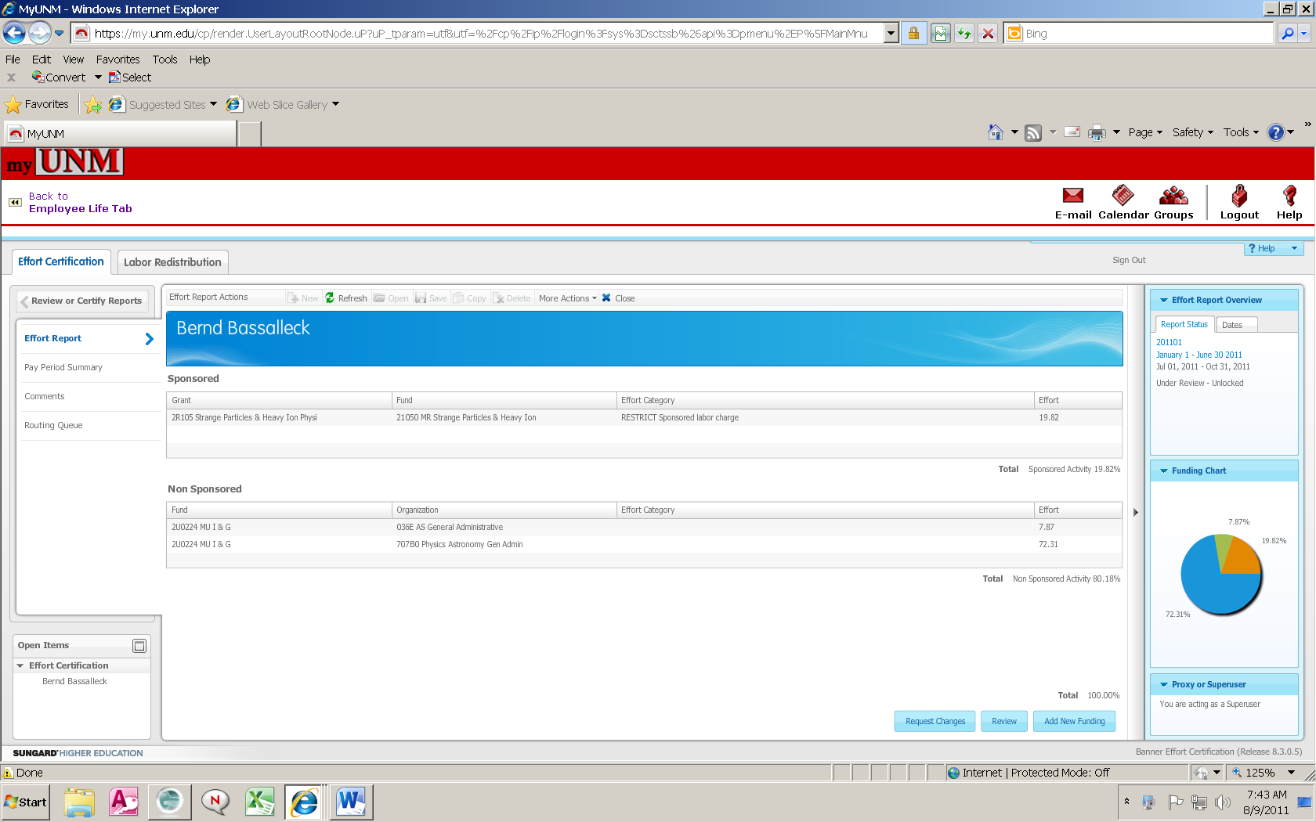
Scenario 1 – Complete Pre-Review
No change necessary for this employee
Click Review button to complete Pre-Review stage
Notes:
Everything ok with the record. Select the “review” button for your action to be completed with this employee. The status of the record changes from under review to awaiting certification if all reviews are completed.
You can click on the “routing queue” tab to see the individuals who have to take action.
To go back to your list of employees click on the Review or Certify reports tab
Email notification will be sent to PI

Slide 26
Scenario 2 – Record needs changes
Pre-reviewer identifies changes needed
    Select Request Changes button; system prompts user to send an e-mail. Send email to department labor re-distribution initiator (if needed), include all necessary information to complete labor re-distribution
Notes:
If corrections need to be made, select the request changes button. The review button disappears and you will be prompted to send an e-mail to the individual who processes labor redistributions in your department.

Slide 27
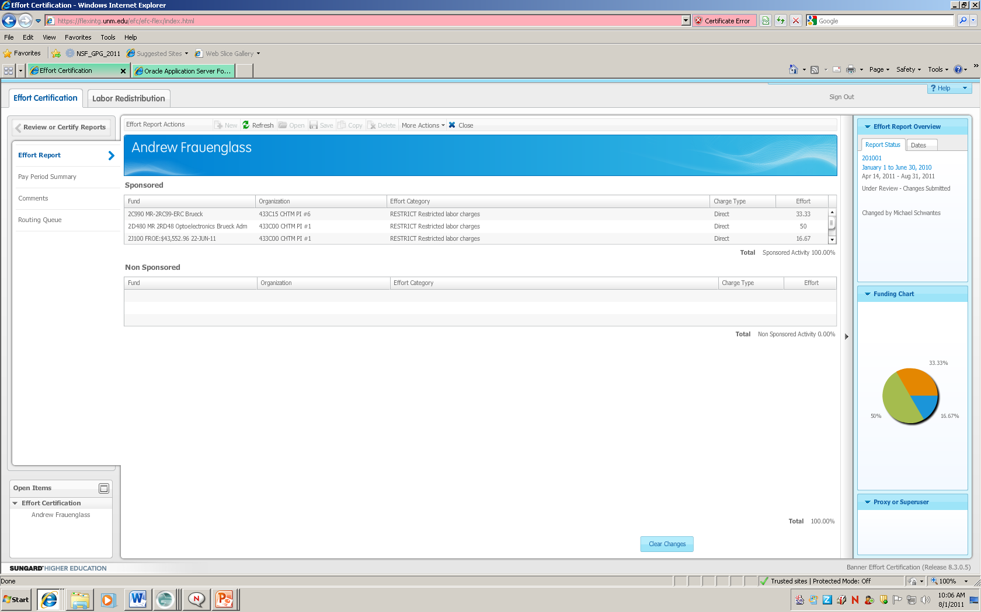
Clear Changes Requested
If Request Changes button was selected in error
Click Clear Changes to restore report to original state to continue process
Notes:
Select the clear changes button if no change is to be made. The upper right box shows who originally selected the request changes button.

Slide 28
Scenario 2 – Labor Re-Distribution has been requested
  Status now Under Review-Changes Submitted and the Review button no longer appears.
Notes:
The status now shows as Under Review – Changes Submitted in the upper right Report Status box.

Slide 29
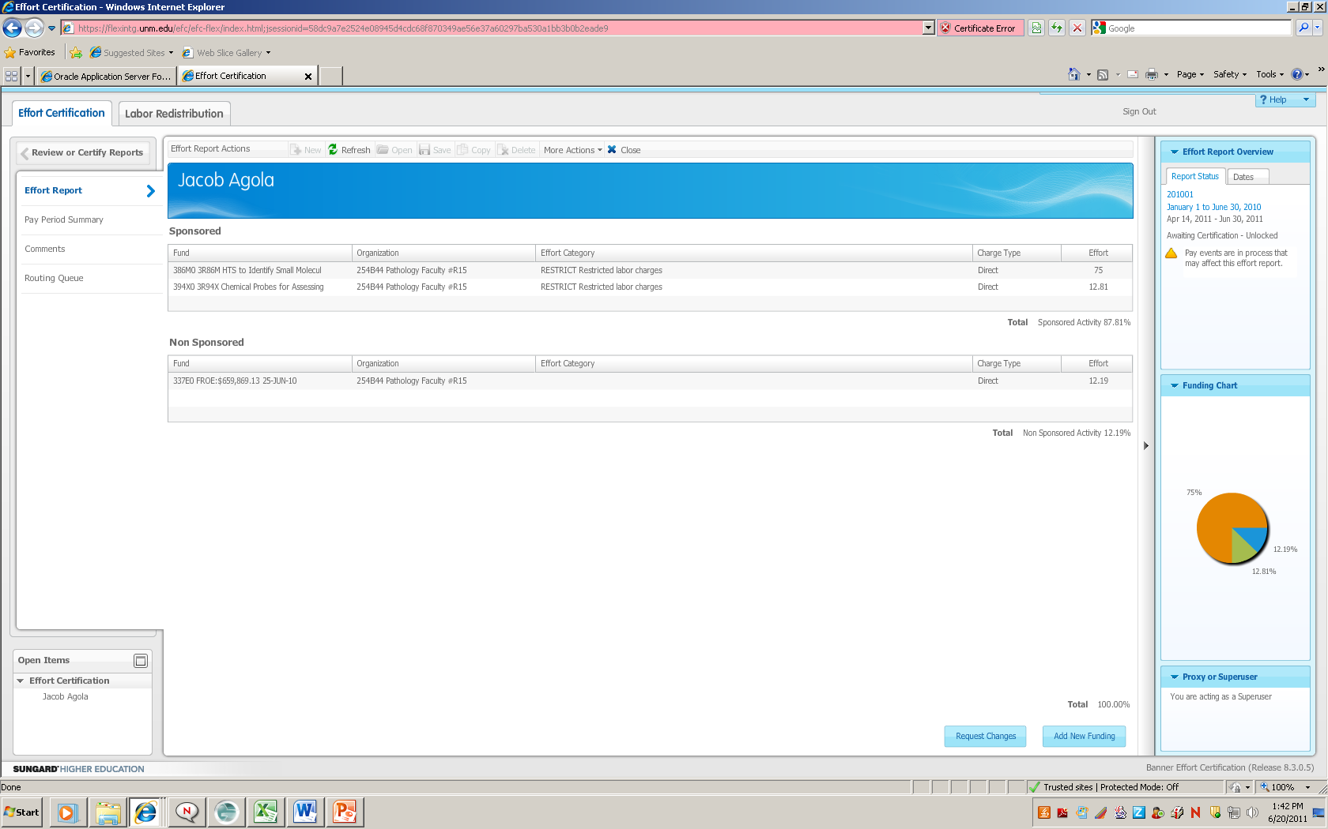
Scenario 2 - Labor Re-distribution completed by Initiator
Labor re-distribution processed by department, has not updated payroll records. Note message in upper right corner
Notes:
After the labor redistribution has been keyed and completed by the department responsible for the employee the Report status box now shows a yellow triangle stating that pay events are in process.

Slide 30
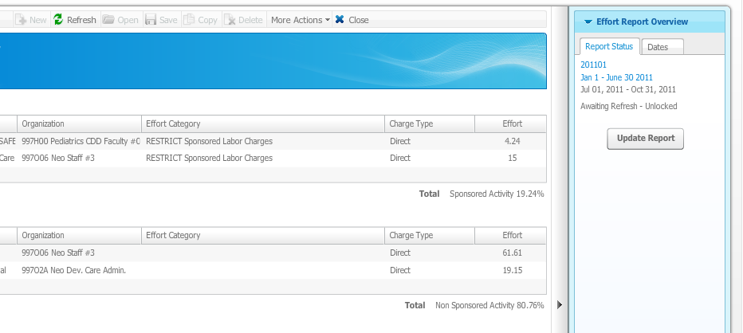

Scenario 2 – Update Effort Report
Changes have been applied and Awaiting Refresh, click the Update Report button to show changes on the effort report
  Available for Pre-review after update is complete
  Status changes to Under Review – Unlocked and the Review action can be taken
Notes:
Once the labor redistribution has been approved and posted in the system and Update Report button appears and when selected refreshes the report to reflect the labor corrections.

Slide 31
Scenario 2 - Complete Pre-Review
Select Review button to complete this stage
Notes:
You can now select the review button to complete your review action.
PI will receive email notification when record is available to certify

Slide 32

Certification Stage
Select Certify button
Complete certification process
  Note: Certification will not be completed until all PI’s have certified

Slide 33
Record is Locked
Once effort has been certified, salary transfers for that period will only be permitted in rare circumstances
  If it is necessary to adjust the salary charges for a previously certified effort period, a detailed explanation of the need for the salary adjustment and subsequent re-certification is required
  Request to open a previously certified effort report memo must be completed and signed by Dean or Director
    Requests can be scanned or sent to your respective C&GA Manager
  Memos will be retained by Contract & Grant Accounting
The Effort Report will need to be reviewed and re-certified
Notes:
Once a report has been certified the record is locked. Changes to records that have already been certified will only be permitted in extremely rare circumstances.

Slide 34
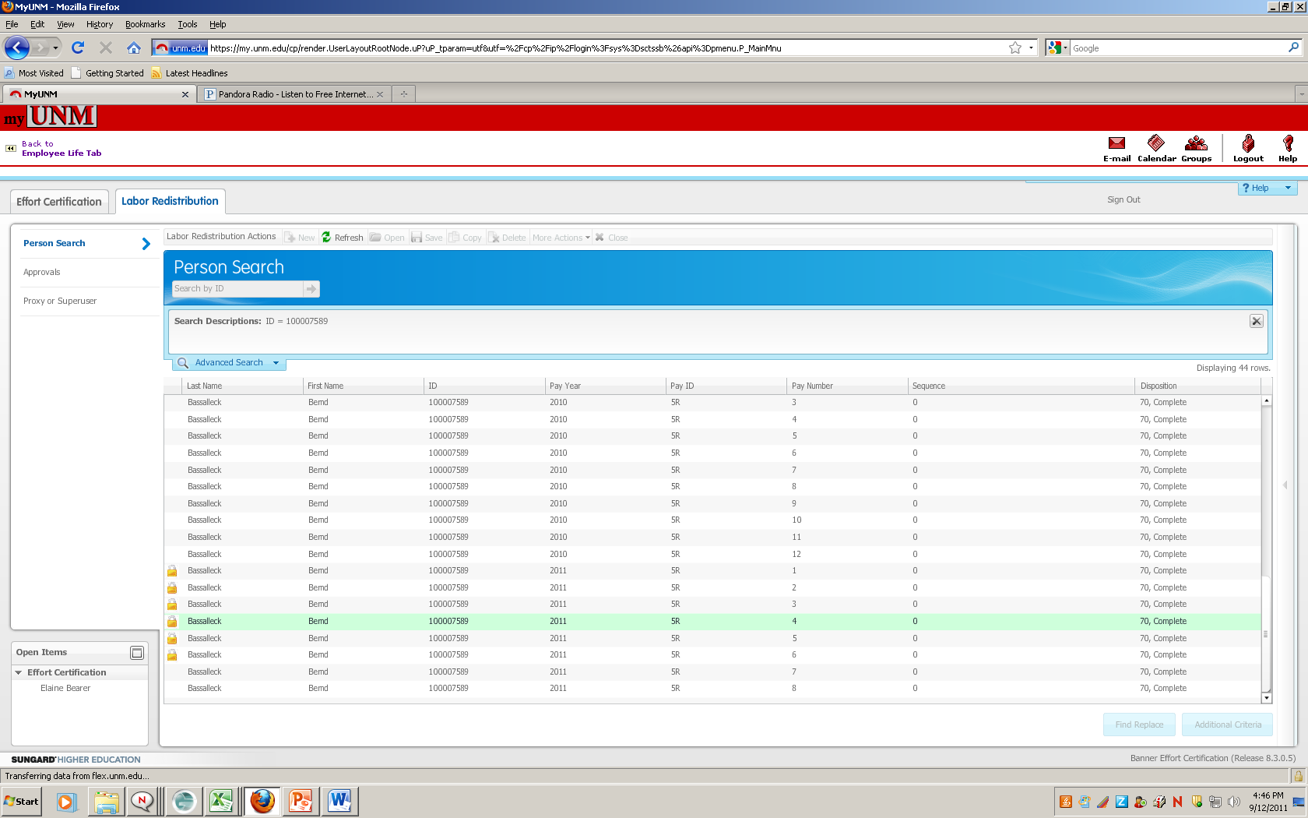
Record is Locked
Self Services Labor Redistribution
Notes:
When you are in self service labor redistribution you will notice locks on the pay periods that have been certified.

Slide 35
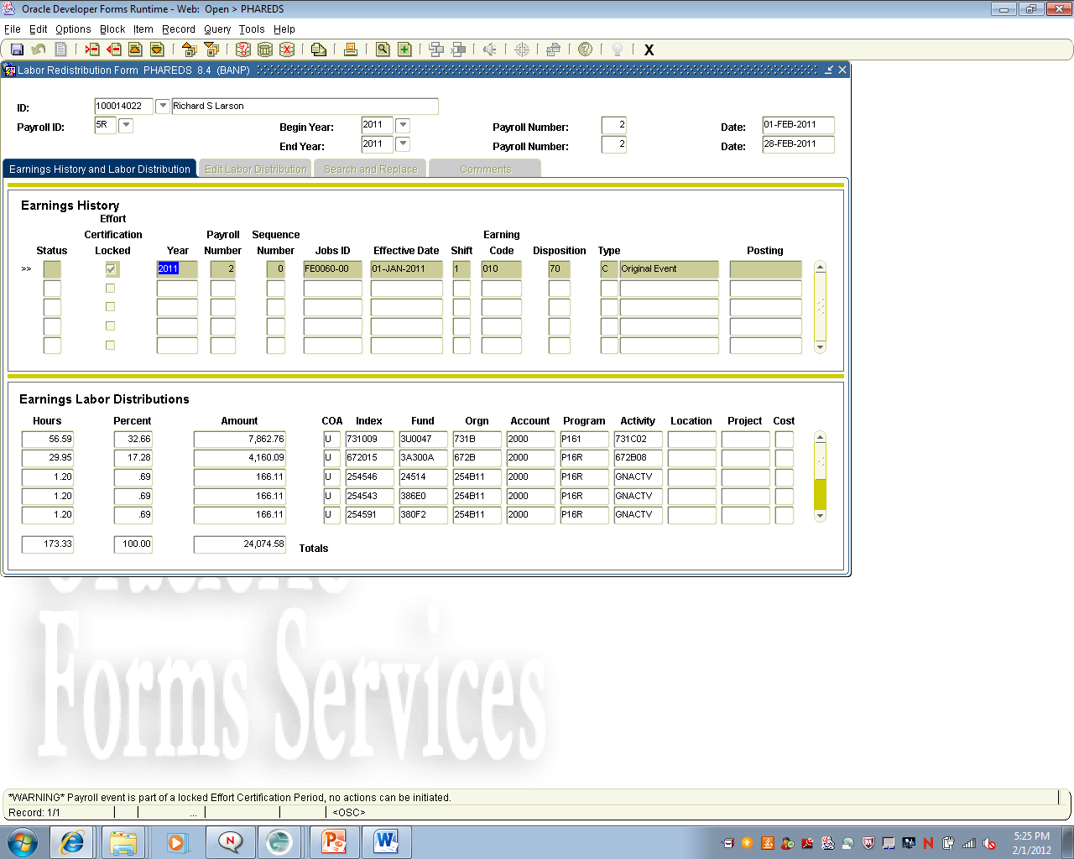
Record is Locked
Banner PHAREDS
Notes:
In PHAREDS you will get a warning when you try to do a correction on a period where the employee was certified and the record is locked.

Slide 36
Potential Consequences*
Ability to submit proposals could be suspended
List of non-compliant PI’s posted on UNM website
Uncertified effort expenses moved to unrestricted index
* to be determined by Research faculty
Notes:
Here are some potential consequences for not fulfilling this federal requirement.

Slide 37
Contact Information
Contact your Pre-Reviewer for general/procedural questions
For all other questions
  Contact: Contract & Grant Accounting office - Main Campus/Branches
    277-4721
  Contact: Contract & Grant Accounting - Health Sciences Center
    272-0163
  Or send Email to:
    Effort-Reporting@salud.unm.edu
Notes:
For questions you can call your contract and grant accounting office or send an email to Effort-Reporting@salud.unm.edu .

