Slide 1
Coordinator Course
The Application Process

Slide 2
This session will cover:
Why was this course created?
Common Abbreviations
Accreditation Timeline
The Application Process
Application Process Flowchart

Slide 3
Why was this course created?
A knowledgeable team works more efficiently.
Gaps in knowledge have been found in some of our RSS Team Members.
Deficiencies were discovered by CPL Staff preparing for our 2020 reaccreditation process.
A resource for new coordinators.

Slide 4
Common Abbreviations
AF - Application Form
EPF - Education Planning Form
PF - Education Planning Faculty - Faculty in charge of activity
Coordinator/RSS Coordinator - Individual assisting faculty with activity
CPL - Office for Continuous Professional Learning
ACCME – Accreditation Council for Continuing Medical Education (our accrediting board)

Slide 5
Accreditation Timeline
All dates are based on a calendar year (January-December)
These dates are for the 2021 Accreditation Cycle
Date | Description | CPL | Department
January 1 | First Day of Accreditation Cycle | X | X
January 10 | Upload Evaluation Summary for July – December 2021 |  | X
February 26 (Last business day in Feb.) | Outcome Summary Due for July 2019-Dec. 2020 |  | X
July 10 | All programs to upload Evaluation Summary for activities held January – June 2021. |  | X
August 30 | CPL to send link for 2022 application | X
October 12 | 2022 Application Form, Education Planning Form and Education Planning Faculty Disclosures are due |  | X
Oct. 11 - Dec 24 | Application Approval and Registration Links are emailed to Faculty and Coordinator (Sent First-Come First-Served Basis) | X
Dec. 31 | Final date for 2021 registrations. |  | X
Dec. 31 | CPL to upload program data into ACCME’s database. | X

Slide 6
Application Flow Chart
The Application Flow Chart on the next slide is an overall picture of the entire application process.
Some of us are visual people, so this may be helpful to you.

Slide 7
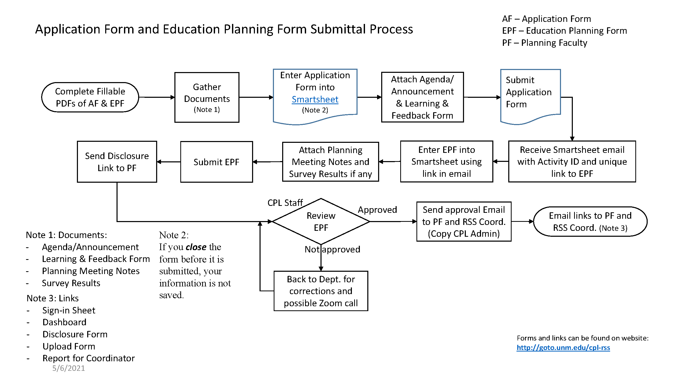
8/27/2021

Slide 8
Application Process - Step One
Many tasks are due prior to January 1st, which is the first day of the accreditation cycle
Late August – Application submittal deadline and links emailed to all Coordinator’s & Planning Faculty
Early October - All documentation due back to CPL.
Application Form (AF) and documentation (see next slide)
Education Planning Form (EPF)
Education Planning Faculty Disclosure Form (PF).

Slide 9
Items uploaded with application - #1
Announcement Template
Department Name
Date and Time of Activity
Speakers Name, Credentials & Presentation Title
Learning Objectives
Disclosure Statement
Accreditation Statement
Click to see Sample Announcement in Coordinator Templates

Slide 10
Items uploaded with application - #2
Learning & Feedback Form – select a template
The first page of each template are the same, because these are the required “CME” questions. Feel free to add any priority specific questions that your department may need.
The second page is where your Planning Faculty must decide how you will assess the learning, and once he/she decides which template to use, this will be uploaded during the application process.
Planning Meeting Notes if any
Survey of Target Audience

Slide 11
Why do we create announcements?
ACCME mandates that we provide the disclosure and accreditation information to the attendee, at the time of the activity.

Slide 12
In-Person versus Virtual
In-Person – the announcement must be posted near the registration desk for all attendees to see.
Virtual – the announcement can be emailed to attendees and included in introduction slides.

Slide 13
Getting Approved – Step two
CPL Staff will review all documents and email the department with any questions. If need be, a Zoom meeting will be setup to clarify any questions.
Approvals are based on a first-come-first-served basis. Submit early!
CPL Staff will email the approval to the Education Planning Faculty and Coordinator; along with the number of credits awarded for their activity.

Slide 14
Registration Links – Step three
CPL Staff will email you the registration links, which are in Smartsheet:
Sign-in Sheet
Disclosure Form for Speakers
Upload Form
Report for Coordinator

Slide 15
Approvals
CPL accredits between 150 – 200 activities per year, so during this busy period, it can take some time to approve your application. Please be patient.
For courses, applications are due 30 days prior to the activity. A rush fee will be accessed if the following items are not received 30 days prior to the activity.
1. Application Form
2. Education Planning Form
3. Education Planning Faculty Disclosure Form
4. The Draft Agenda

Slide 16
Training
The application process is entered into our Smartsheet system. Training is available through our office for this submittal process, as well as the registration process. Contact us at 505.272.3942 or email us at
HSC-CPL@salud.unm.edu.

Slide 17
Questions?
Anytime you have questions about this process, please know that you can call one of the CPL Staff. We are here to help and guide you through the process.

Slide 18
Regularly Scheduled Series (RSS) Team
Operation’s Specialist, Kathy Breckenridge
272-6707, Kbreckenridge@salud.unm.edu
Administrative Assistant III, Jennifer Harbaugh
272-3942, Jharbaugh@salud.unm.edu
Grand Round Assistant, Alexandra (Alex) Hurst
272-3942, HSC-CPL@salud.unm.edu
General Email: HSC-CPL@salud.unm.edu

